Slide 1
VAN & BUS RENTAL WEBSITE
(V&B rental)
Pannawat Niyomrat 5904062663123

Slide 2
GOAL
For van and bus rental by date to date.
Make easier for customer to plan the rental online (instead of go to station).

Slide 3
Scope
1.User have to registered an account before booking.
2.User can change password
3. User can rent van or bus by booking the vehicle in website.
4. User can cancel booking vehicle in website before pay.
5. When booking, user have to enter the period of time for rents to calculate price.
6. User can select payment methods (Credit card, ATM, Mobile Banking).
7. All user data will stored in Database.

Slide 4
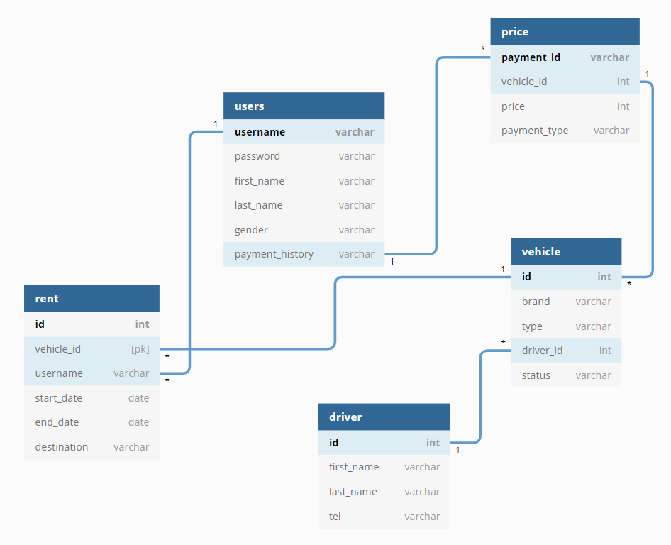
Database Diagram

Slide 5






Dev. Tools
HTML
CSS
JS
Bootstrap
jQuery
Web Storm

Slide 6
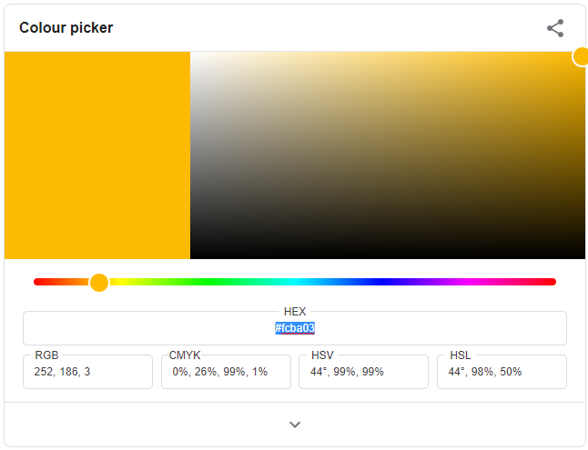
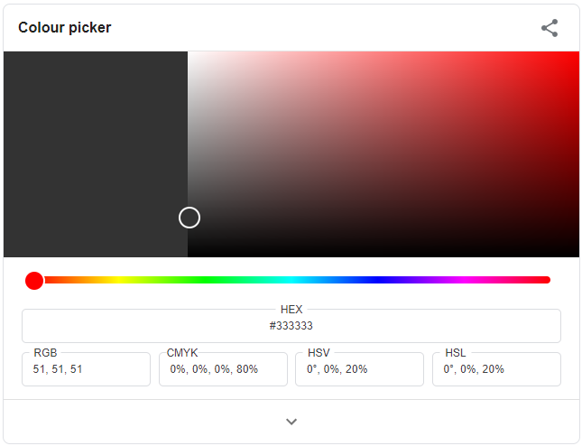
Website Color scheme #fcba03 #333333

Slide 7
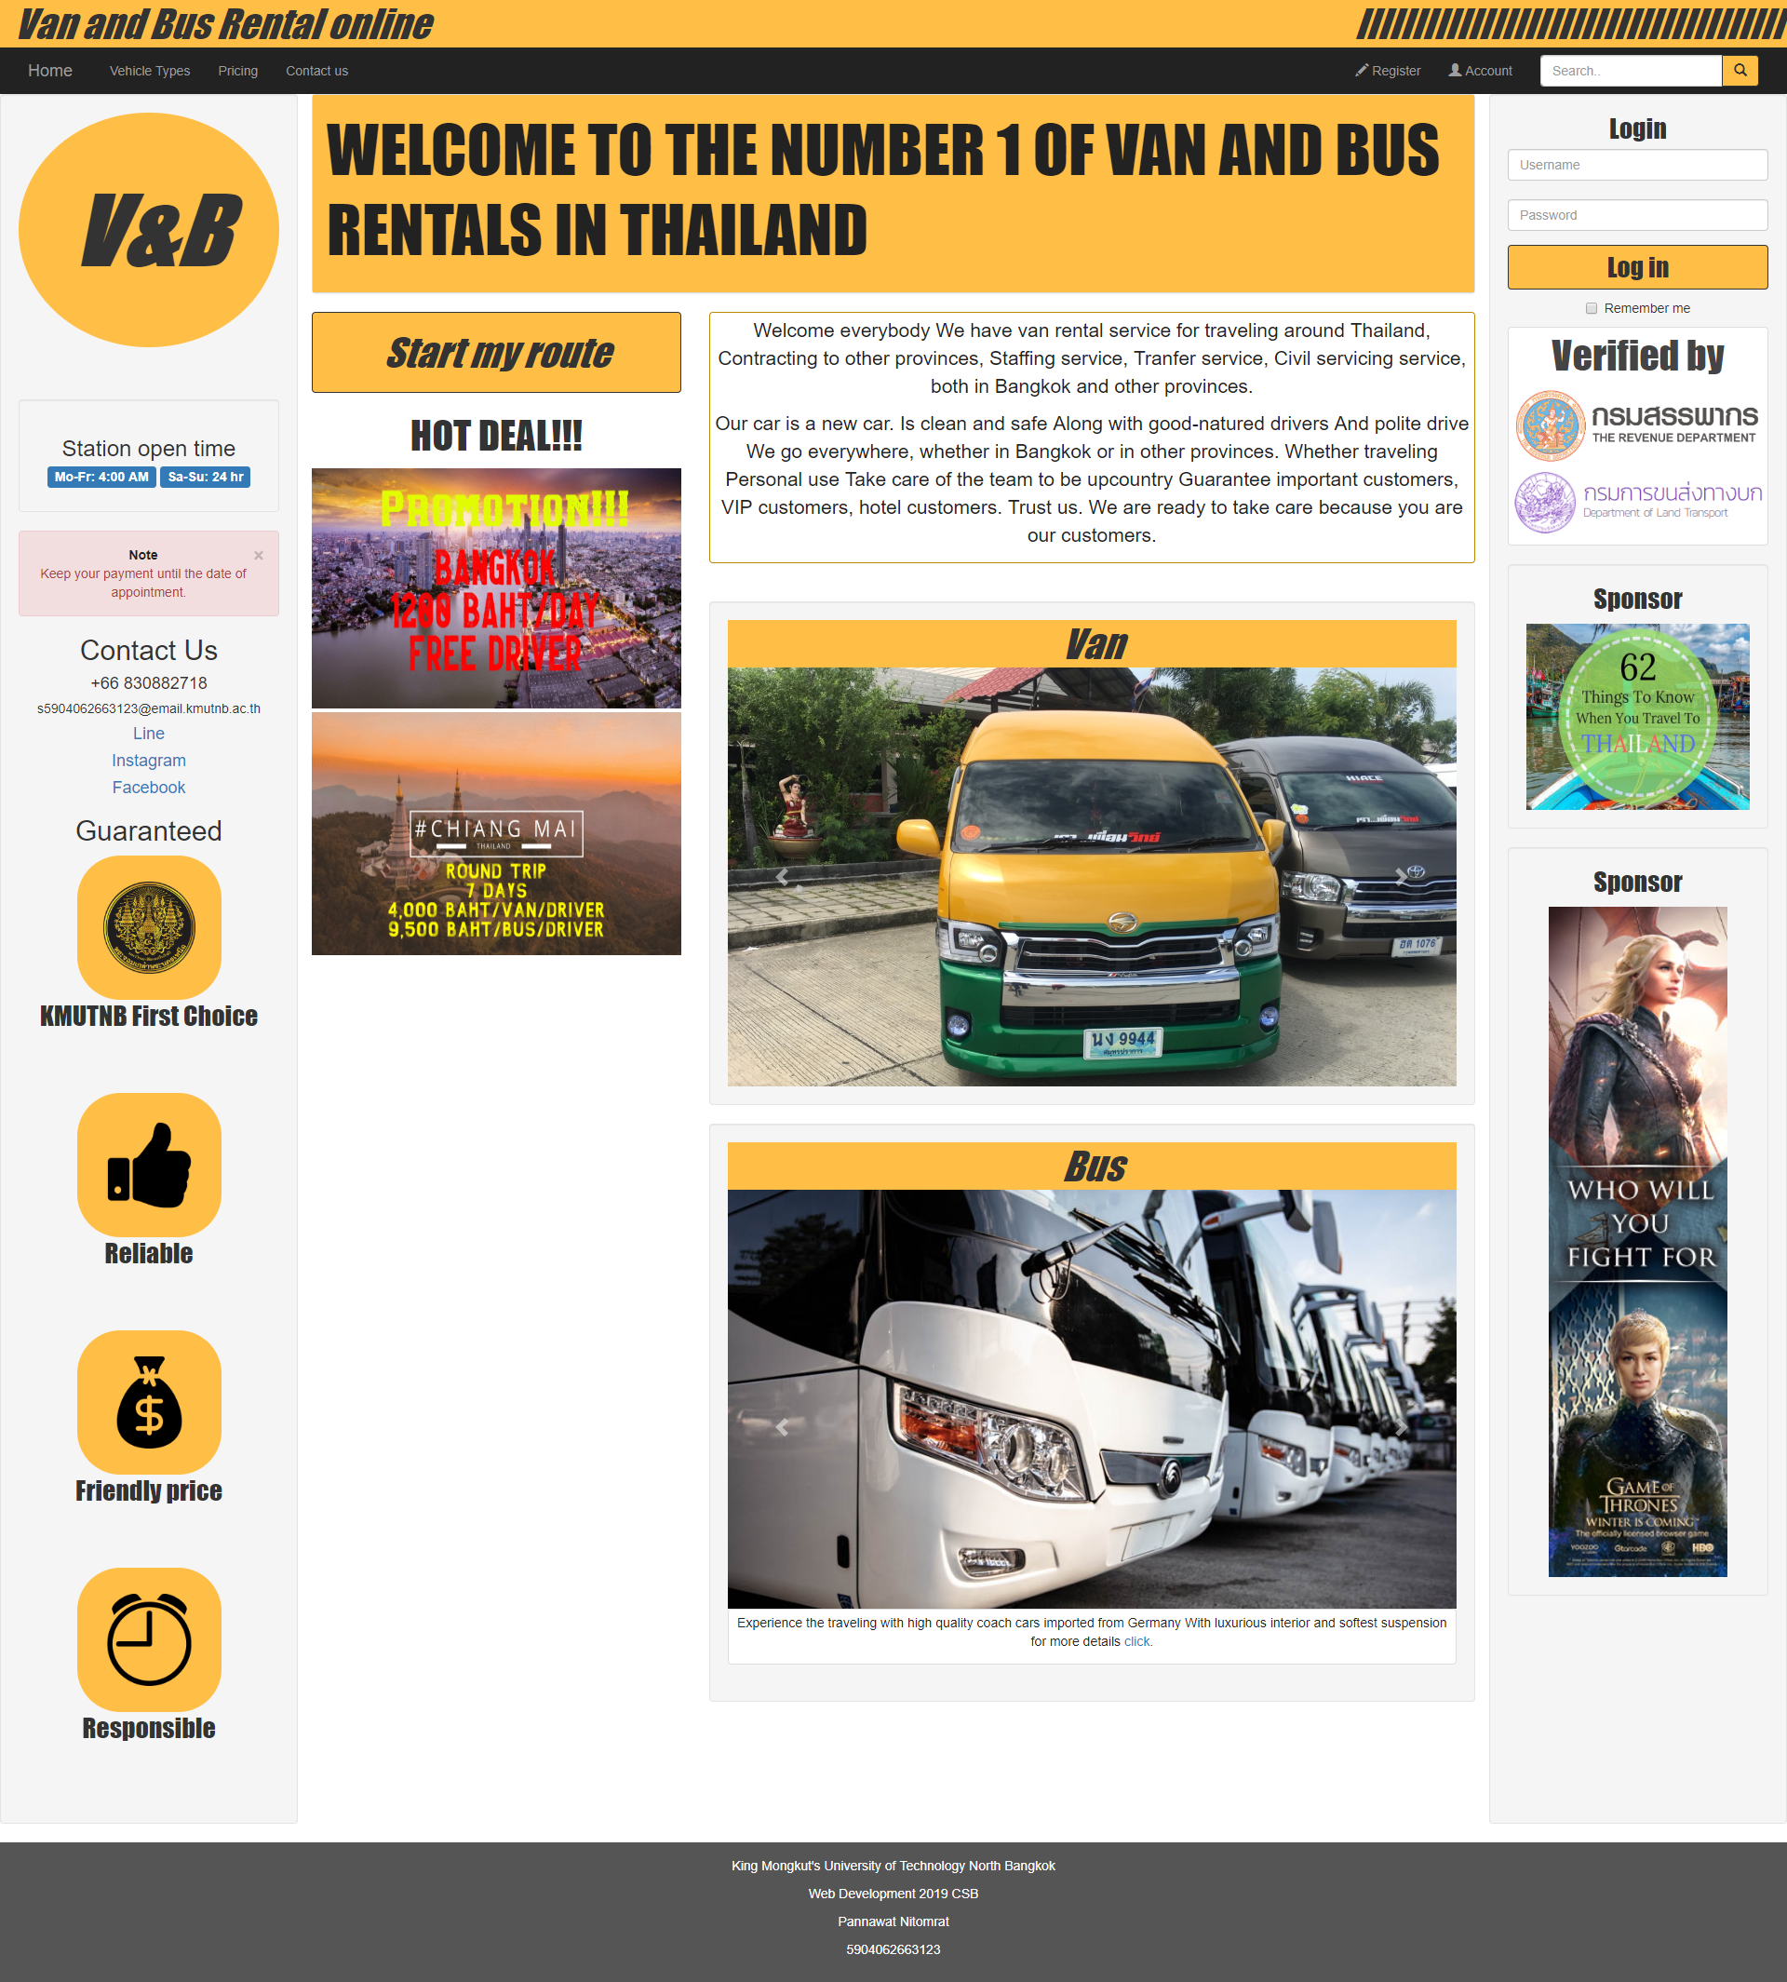
Screen shots Home Page →

Slide 8
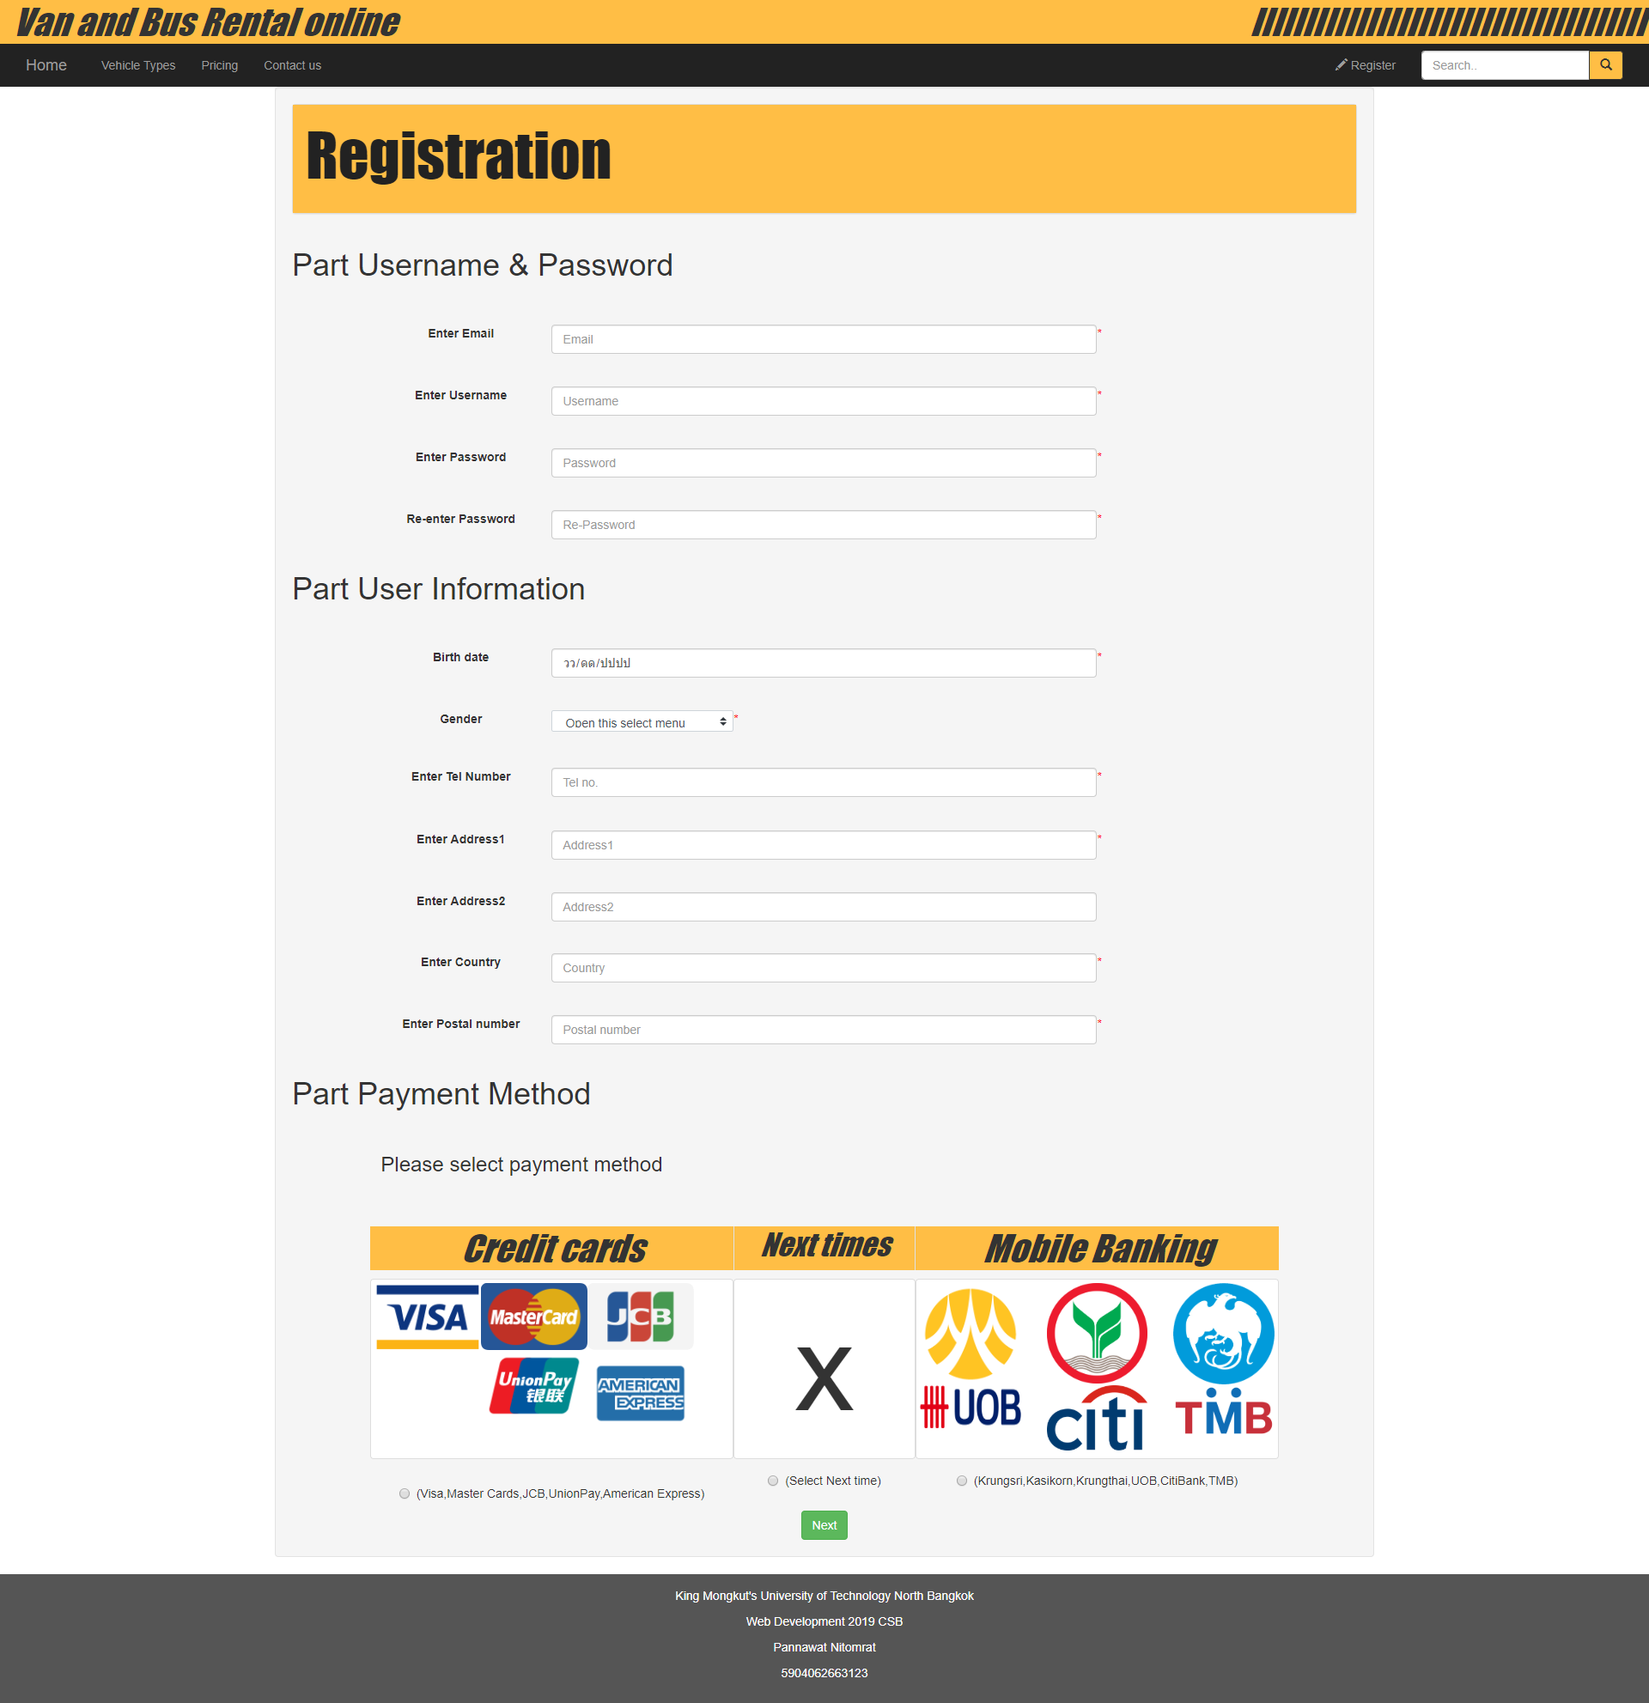
Screen shots registration Page →

Slide 9
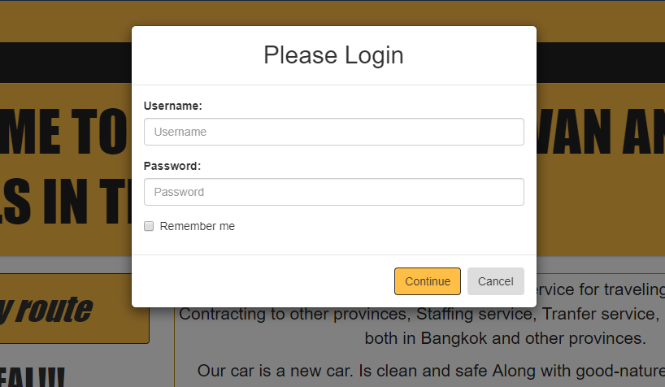
Screen shots Login by modal→

Slide 10
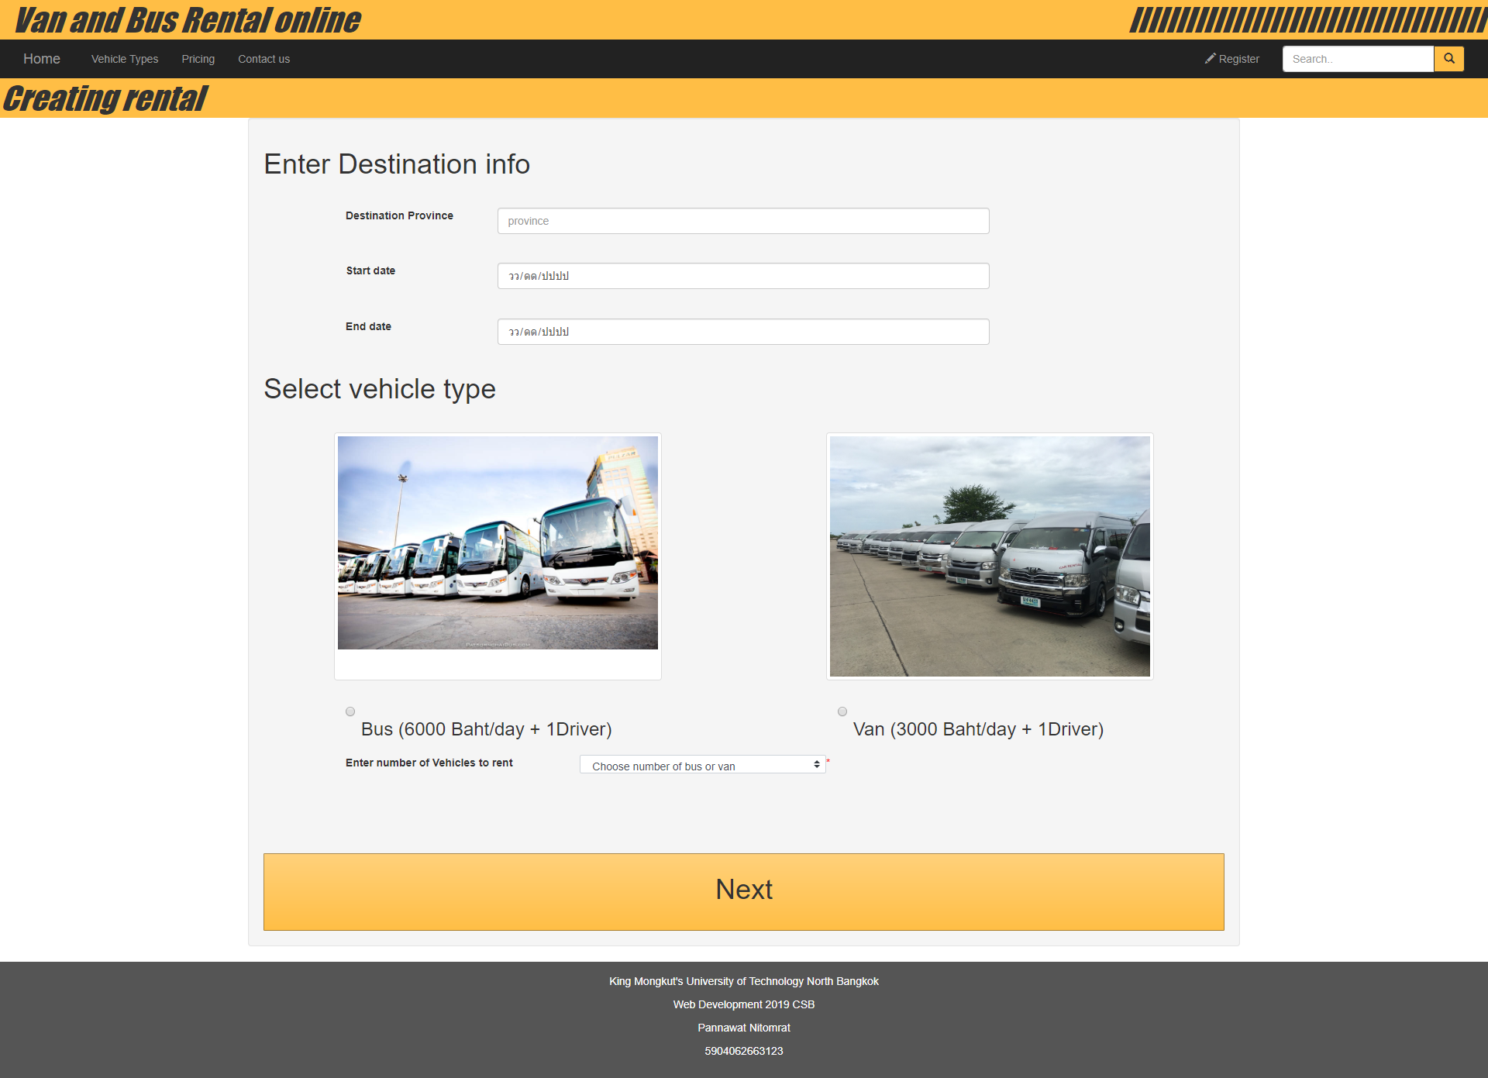
Screen shots Creating rental

Slide 11
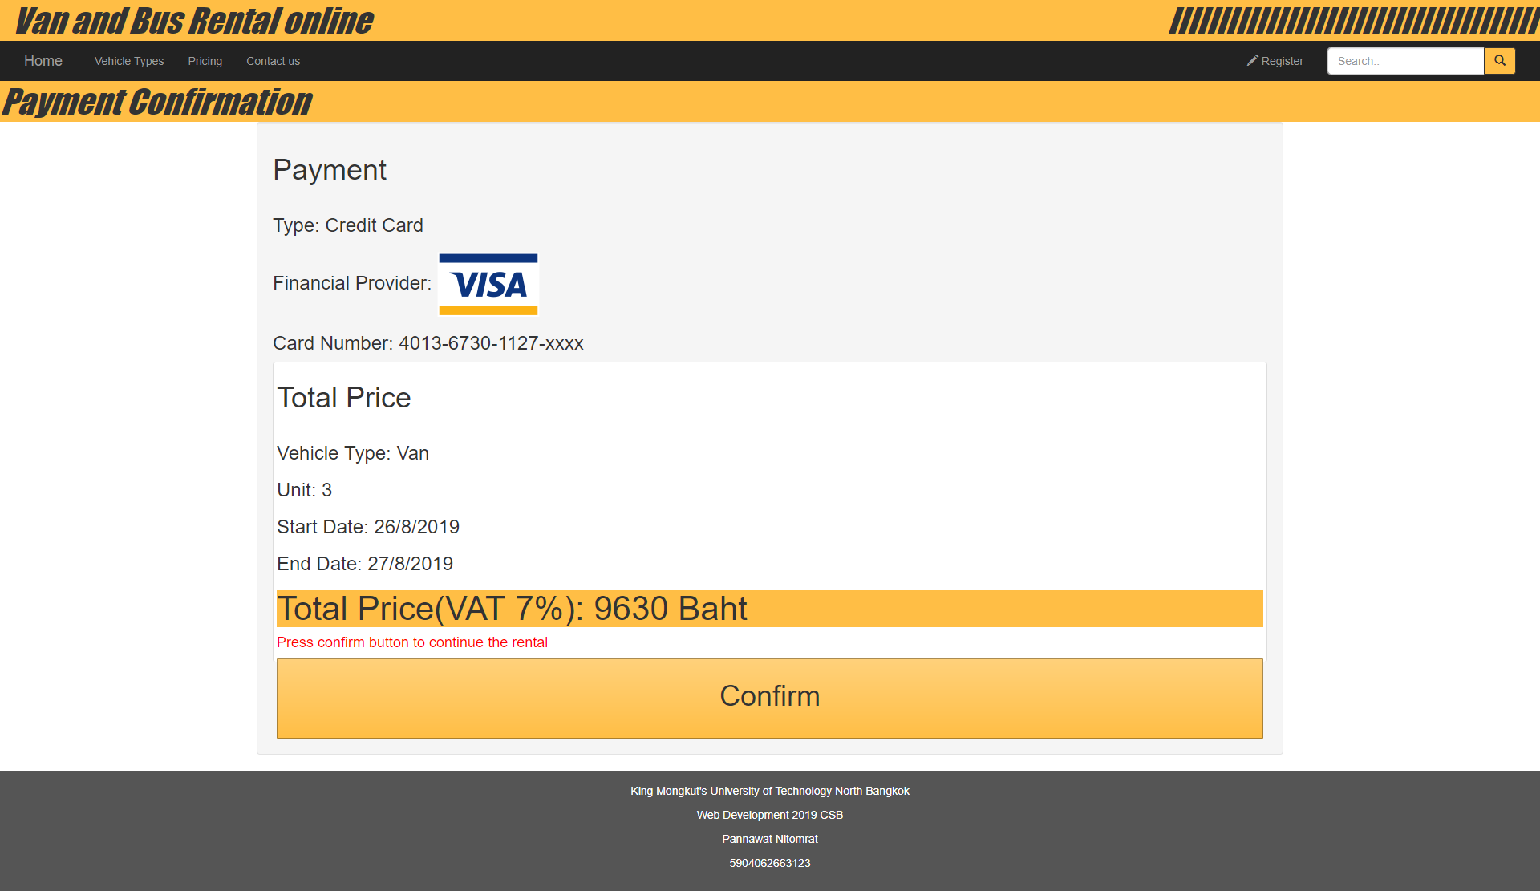
Screen shots rental confirmation

Slide 12
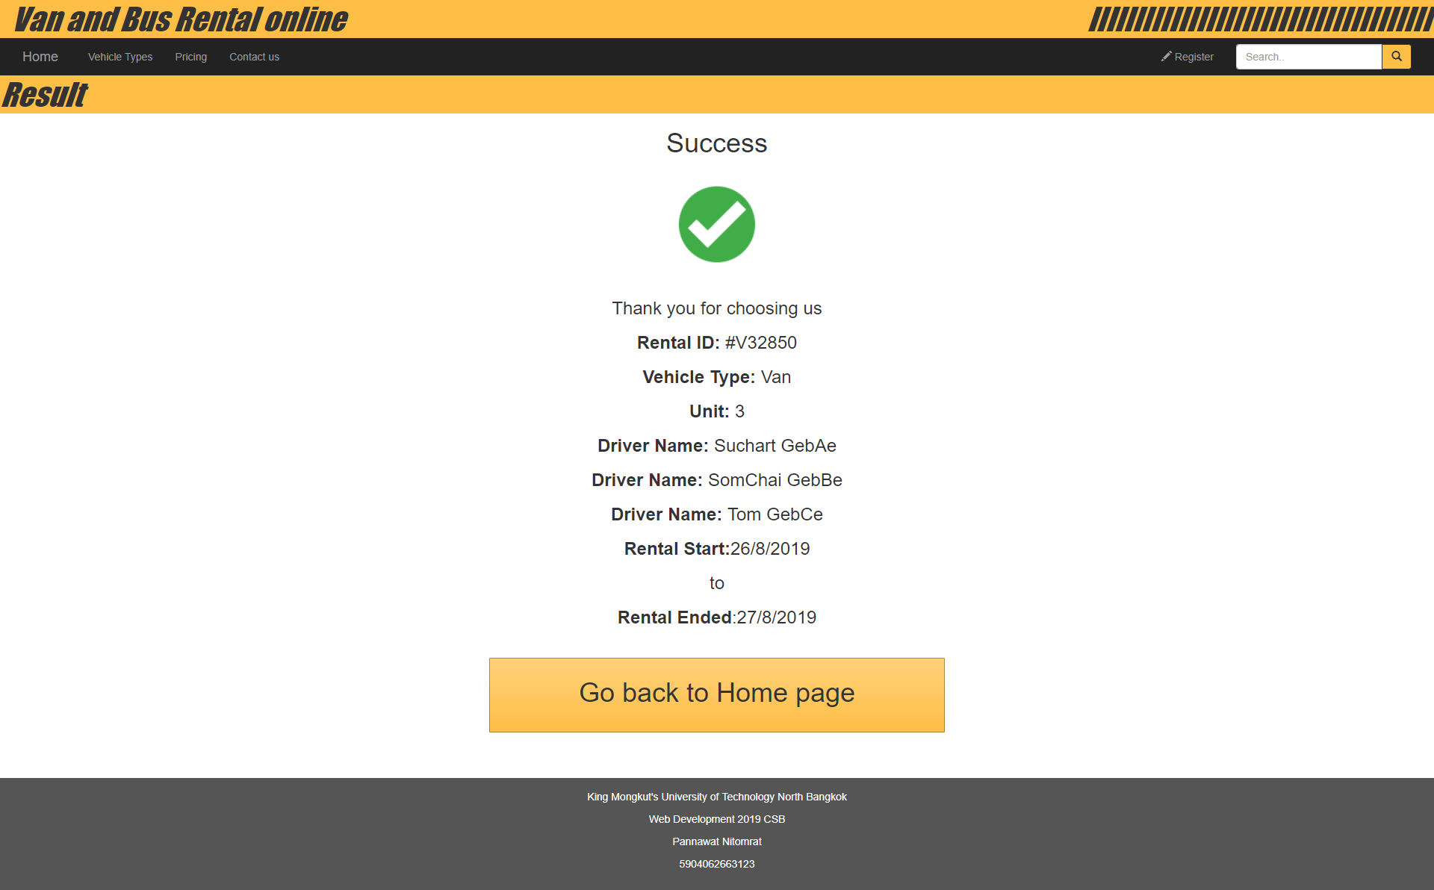
Screen shots rental Complete

Slide 13
<THANK YOU />

